Slide 1
2021 Paramedic CE
IV pump tips, Pedi-safe reminder demo, trauma arrest notes, one scope welcome

Slide 2
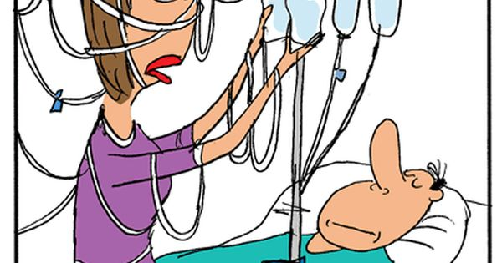
You want me to continue what?

Slide 3
Tips for choosing channels…
Which channel to use to find the needed medication with dosages…
Do we carry the medication?
No- Use the X Master or transfer list
Yes- How old is the patient?
Adult- choose the adult list
Child- choose the child list

Slide 4
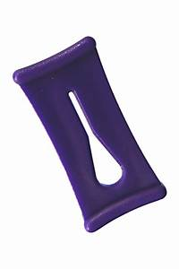
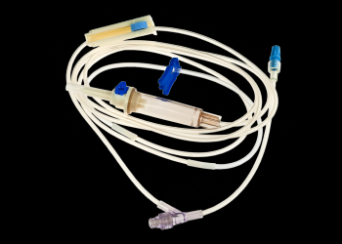
How to get started
The KEY to getting started is having a KEY to open the unit

Slide 5
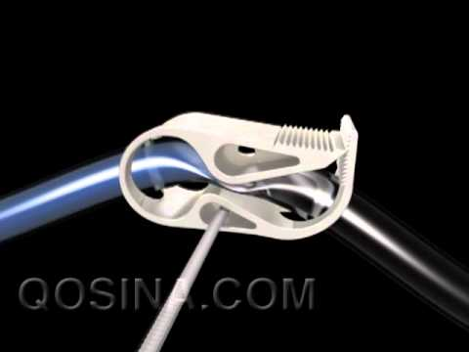
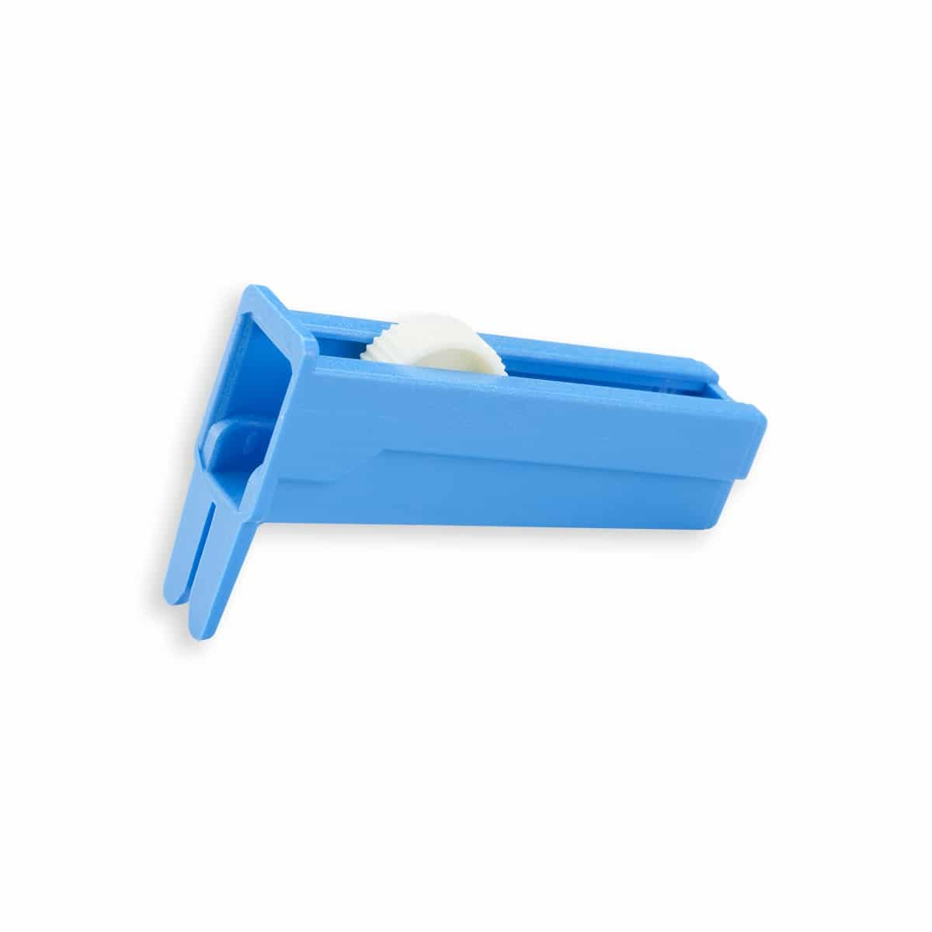
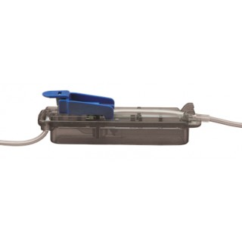
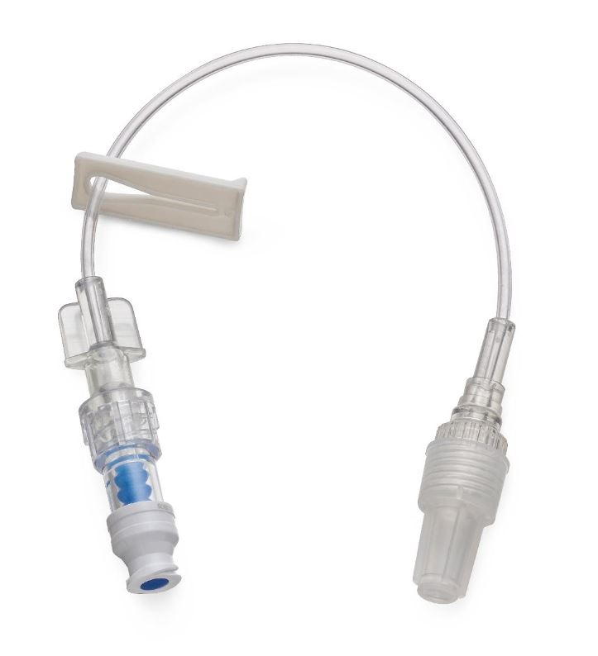
So I have to change tubing every time?
N
O
P
E

Slide 6
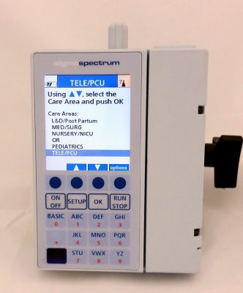
How to find the medication…..
Start by typing the first three letters of the medication.
Think about the medication name.
What is the name of Normal Saline?
NS?
NaCl

Slide 7
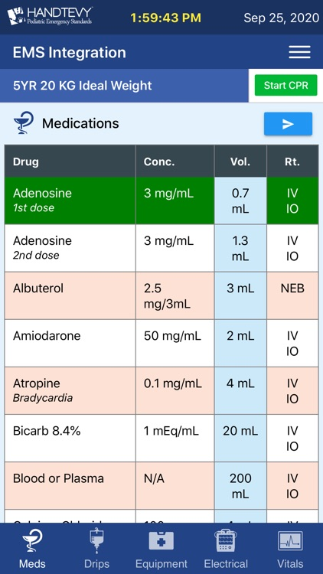
I don’t like figuring drip rates…..
Who does????
That is why we pay for Handtevy….
Just click drips

Slide 8
Oh, I don’t have that…..
Why not????
Go to www.christusems.org
User ID: your CHRISTUS EMS email (miranda.hagans@christusems.org)
Password: your CHRISTUS EMS email password
Click Courses at the top of the page
Search for Handtevy
Watch the short video
Take the quiz (last question gives you the ID and password for the app)
Download the FREE Handtevy app into your phone… or use it from your toughbook

Slide 10
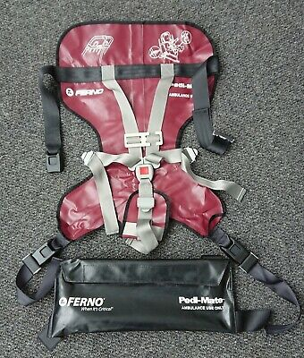
PEDI-SAFE….
What’s that?
Pediatric Transport Restraint…… “car seat for cot”
Do we have one?
YES
What size kid fits in it?
From 10kg and up
How do you use it?
It’s easy, let us show you……

Slide 12
Trauma Arrest
BILATERAL NEEDLE DECOMPRESSION
HIGH QUALITY CPR
AIRWAY (I GEL, ET IF I GEL FAILS)
CONTROL BLEEDING, PELVIC BINDING
IV ACCESS X 2 LARGE BORE
FLUID 2 LITERS
REDUCE LONG BONE FRACTURES
ROSC????

Slide 13
NOW On to Documentation
Documentation…….. NOT AGAIN……
Just one part….
“Injuries incompatible with life????”
What is that?
DO NOT USE THESE WORDS!
USE THESE……
Rigor mortis
Dependent lividity
Decapitation and/or hemicorporectomy
Incineration with no signs of life
Decomposition
Black tagged under START
Blunt or Penetrating Trauma WITH
No signs of life AND Asystolic

Slide 14
NEW TOYS!!.....
WELCOME TO VIDEO LARYNGOSCOPY…….

Slide 15
Indications for use…
Any patient that is in need of an advanced airway WITH contraindications to an I-gel or in the event of I-gel failure.

Slide 16
Contraindications…
NONE
What does that mean?????
It means this is your 1st line intubation equipment.
You may move to Direct Laryngoscopy if this fails.

Slide 17
Complications…
Same as with other intubations:
Hypoxia
Bradycardia
Airway injury
Esophageal Intubation
Remember your 3 hard stops, which are?????
Hypoxia (94%)
Hypotension (90 systolic)
Gross contaminated airway (SALAD park)

Slide 18
Documentation…
The One Scope has a video feature on it.
For QA/QI purposes you must video your intubation attempt including the monitor after intubation to show the ETCO2 and SPO2 readings.
These will automatically save to the device. These are not to be accessed by ANYONE other than shift commanders or RMs.
They are also NOT to be erased by anyone other than shift commanders or RMs.
Once you have completed the call, you must notify AOC so they can arrange for someone to come and download the video.
These will be loaded into a secure server for Michael Williams and Dr Dunnahoo to review and then deleted within 7 days.

Slide 19
How to use it…..

Slide 20
Care and cleaning…
The one scope AND rigid stylet are reusable.
DO NOT THROW STYLET AWAY
The handle and charging cords will be stored in the orange pelican cases in the airway cabinet of your ambulance.
The stylet and blades will be stored in your airway roll (they will not fit in the case)

Slide 21
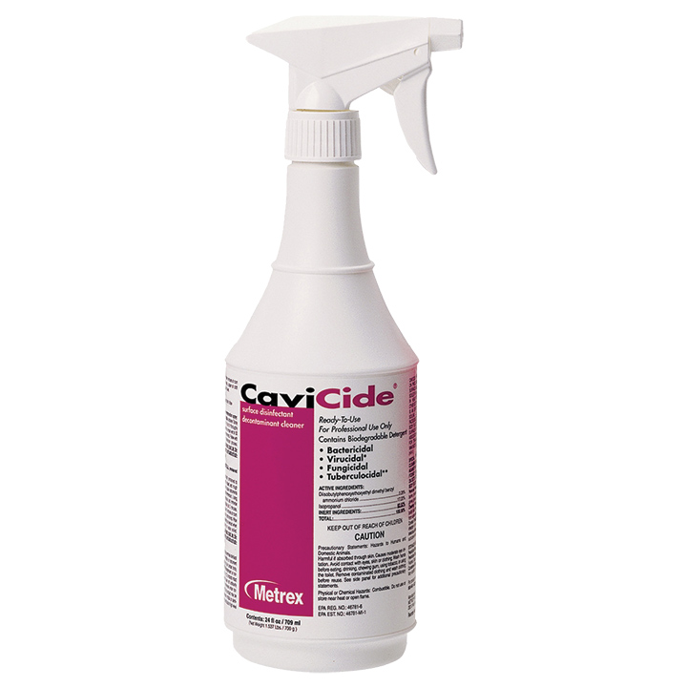
Cleaning…
The handle, display, and rigid stylet MUST be disinfected and cleaned between EACH patient
This must be done with ONLY approved cleaning methods and equipment

Slide 22
Steps for cleaning…
Handle/Screen
Start at the top with a sani-wipe and wipe with a downward motion to clean screen, handle, and blade.
Once clean, detach the blade and place back in packaging and dispose in red bag container.
Rigid Stylet
Clean large debris off rigid stylet with water at 91-104 degree temperature (hot water from tap) and use toothbrush to loosen visible debris/contamination.
Place stylet in ziplock bag and cover all surfaces until wet with cavicide spray and zip closed.
Let sit wet for at least 3 minutes (until back to station).
Brush all surfaces of stylet to clean.
Rinse for 5 minutes under running water (91-104 degree water)
Visually inspect stylet to insure there is no residual contamination. (Repeat if necessary)

Slide 23
Steps for cleaning continued…
Using a clean provided lint-free cloth, dry the stylet
Inspect if for any damage or cracking
Place clean stylet in clean ziplock bag and return to airway roll

Slide 25
Please Return
And Be Ready to Learn
At 1:00

